Slide 1


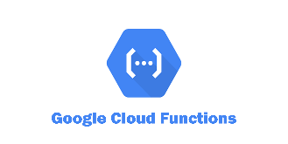

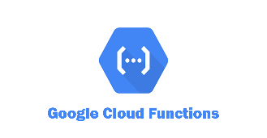
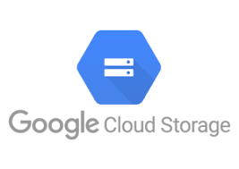
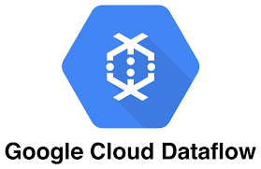



Solution Design
Google Cloud Platform
Source
Publish to
Pub/Sub
topic
Pub/Sub for Real time data Ingestion
Lightweight transformation and Ingestion to Big query
Covid Dataset
Stream
Pub/Sub Event trigger
Storage Event
trigger
Transform and store to GCS
Trigger Dataflow Job
Read from GCS and store to Big Table
Curated Area
Covid Dataset
CSV Files
Data Transfer via Airflow
Staging Area
Notify Pub/Sub
Transform and store to GCS
Trigger Dataflow Job
SSH to Data Server
Using airflow operator
Curated Area
Airflow/Composer for orchestrating Workloads
NoSQL Data store

Slide 4
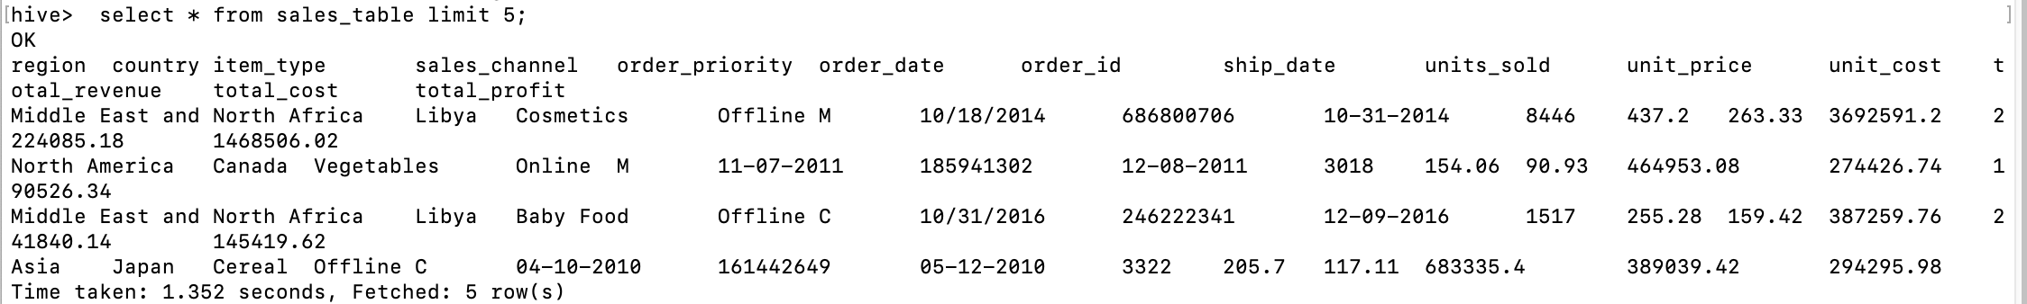

Slide 5
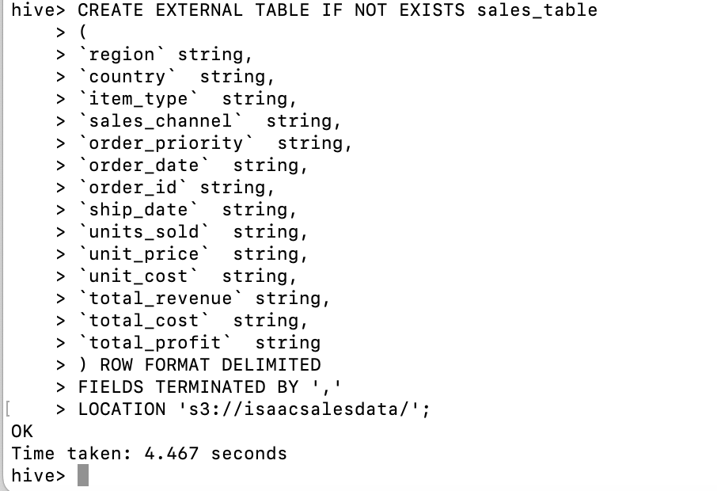

Slide 6
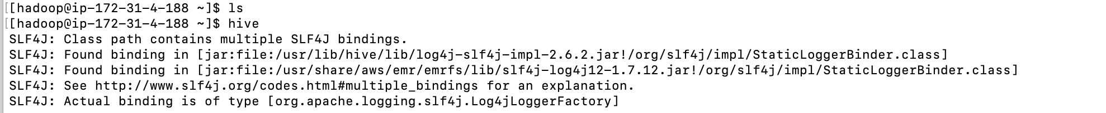

Slide 7
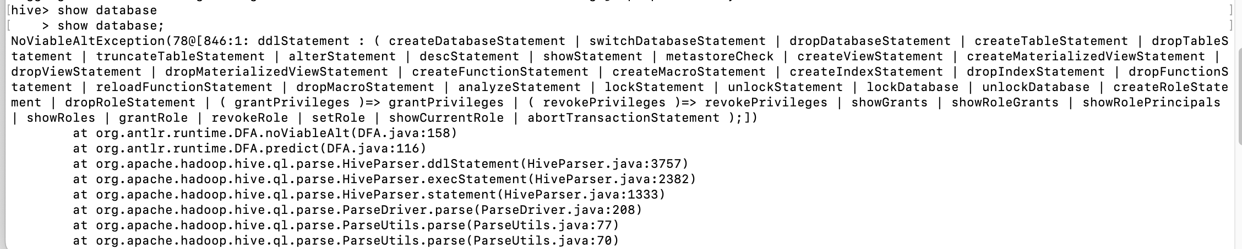

Slide 8
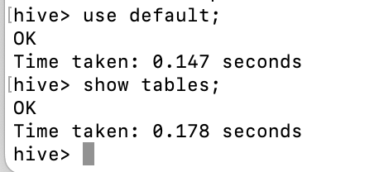

Slide 9
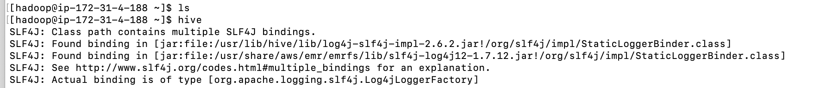

Slide 10
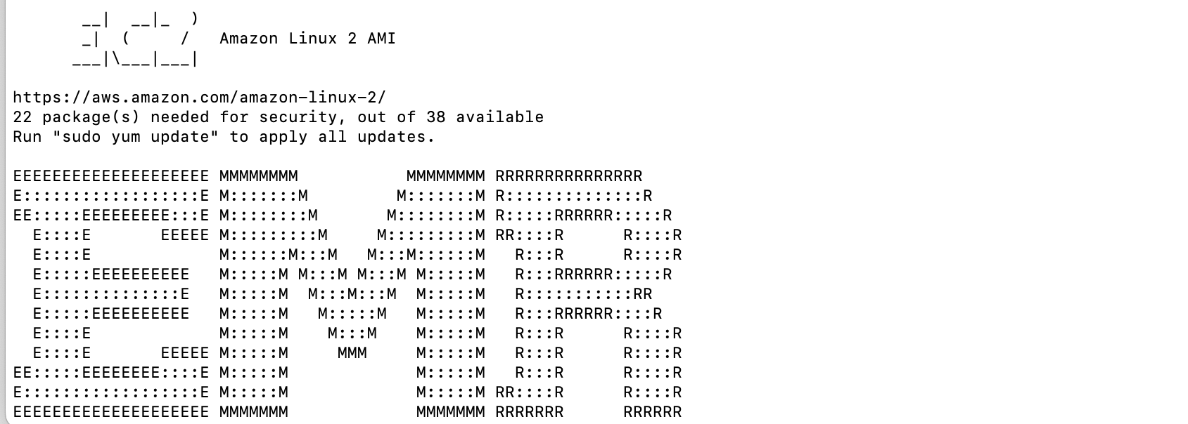

Slide 11
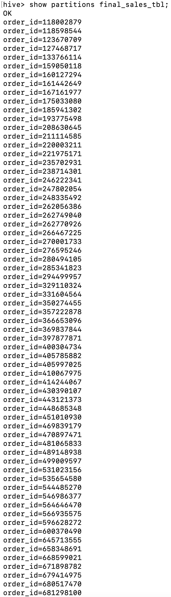

Slide 12
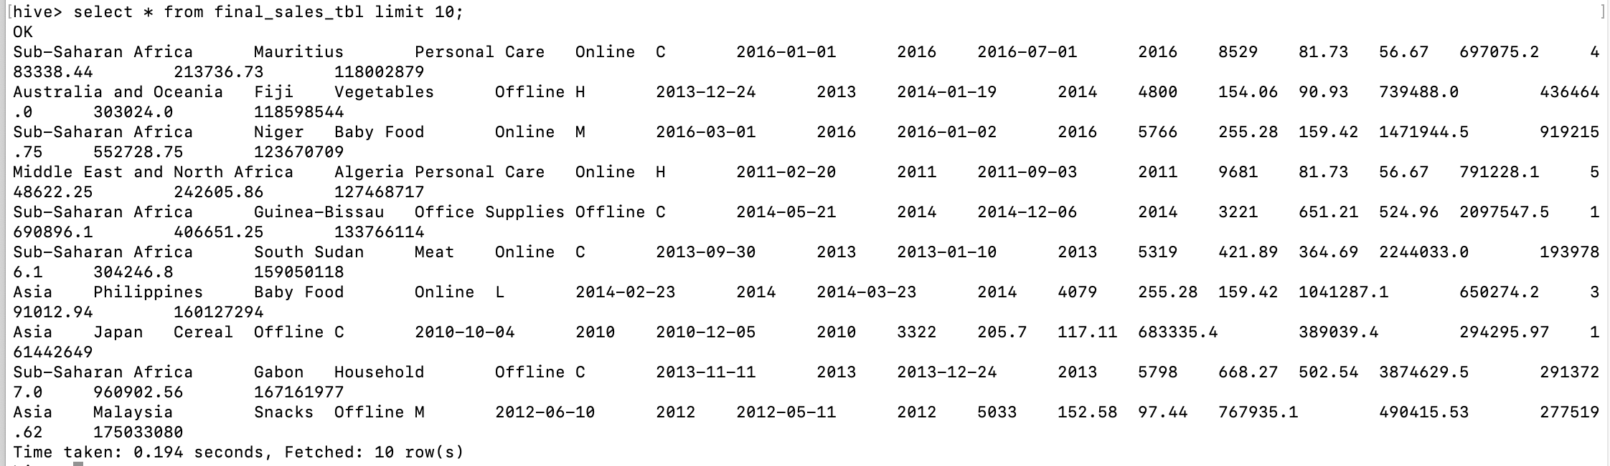

Slide 13
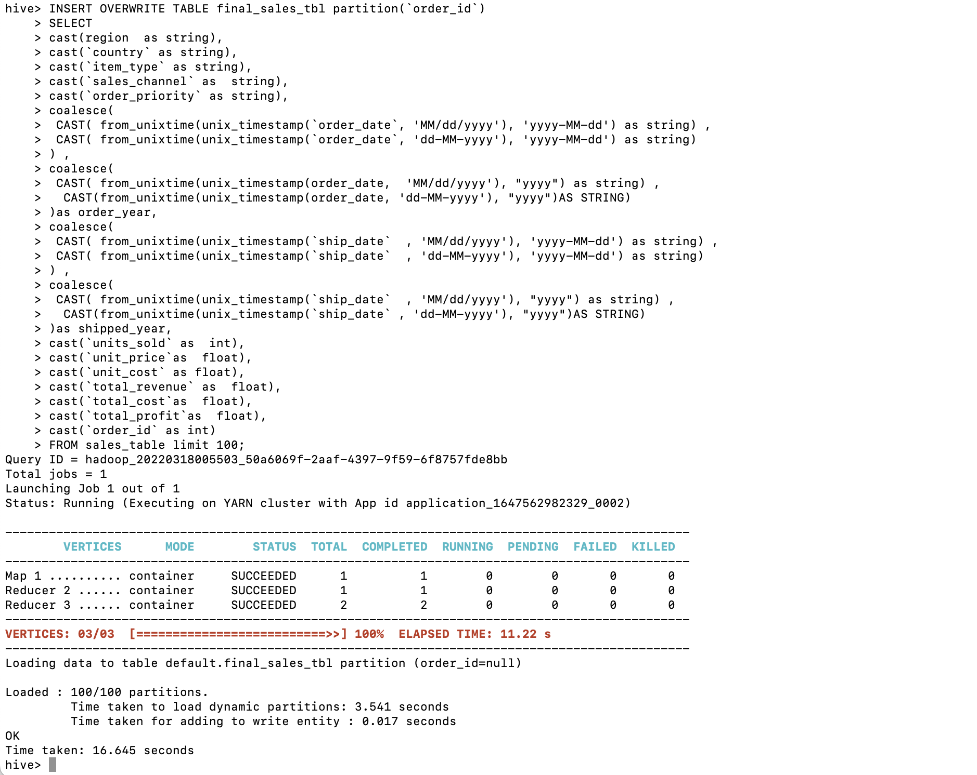

Slide 14
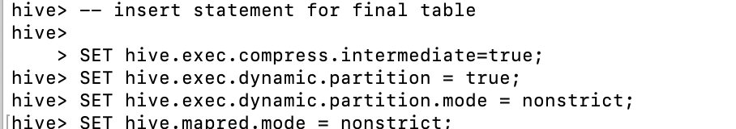

Slide 15
